Slide 1
21. Data Structures for Disjoint Sets

Slide 2
Disjoint Sets
Disjoint-set Data Structure: maintains a collection {S₁, S₂, …, S_{k}} of dynamic disjoint sets.
Sets share no common members
No need to support set intersection.
Each set is identified by a representative, which is a member of the set.
Applications:
Connected component analysis
Applications that can be described by equivalent class!

Slide 3
Supported Operations
Let x be an object:
Make-Set(x): makes a singleton set with x.
Union(x, y): unites the two disjoint dynamic sets that contain x and y, say S_{x} and S_{y}, into a new set that is the union of these two sets. Conceptually, the old sets are destroyed. In practice, we often absorb the elements of one of the sets into the other set.
Find-Set(x): returns a pointer to the representative of the unique set containing x.

Slide 4
Disjoint Sets - Analysis
Analysis of running time in terms of two parameters:
n: number of Make-Set operations
m: total number of Make-Set, Union and Find-Set operations.
Each Union operation reduces the number of sets by 1
Recall sets are all disjoint, maximum: n – 1 Unions
Also m ≥ n (assume that the n Make-Set operations are the first performed)
Example of use: connected components in an undirected graph.

Slide 5
An Application of Disjoint-set Data Structures
CONNECTED-COMPONENTS(G) for each vertex v ∈V[G]
do MAKE-SET(v)
for each edge (u, v) ∈E[G]
do if FIND-SET(u) ≠ FIND-SET(v)
then UNION(u, v)
SAME-COMPONENT(u, v) if FIND-SET(u) = FIND-SET(v)
then return TRUE
else return FALSE

Slide 6
Disjoint sets for connected component analysis
a
b
e
f
h
j
c
d
g
i
Edge Processed | Collection of disjoint sets
initial sets | {a} | {b} | {c} | {d} | {e} | {f} | {g} | {h} | {i} | {j}
(b, d) | {a} | {b, d} | {c} |  | {e} | {f} | {g} | {h} | {i} | {j}
(e, g) | {a} | {b, d} | {c} |  | {e, g} | {f} |  | {h} | {i} | {j}
(a, c) | {a, c} | {b, d} |  |  | {e, g} | {f} |  | {h} | {i} | {j}
(h, i) | {a, c} | {b, d} |  |  | {e, g} | {f} |  | {h, i} |  | {j}
(a, b) | {a, b, c, d} |  |  |  | {e, g} | {f} |  | {h, i} |  | {j}
(e, f) | {a, b, c, d} |  |  |  | {e, f, g} |  |  | {h, i} |  | {j}
(b, c) | {a, b, c, d} |  |  |  | {e, f, g} |  |  | {h, i} |  | {j}

Slide 7
Linked-lists Implementation
Set {c, h, e, b}
c
h
e
b
head
tail
Set {f, g, d}
f
g
d
head
tail
UNION of
two Sets
f
g
d
c
h
e
b
head
tail

Slide 8
Linked-lists Implementation (II)
First Implementation: Linked Lists with head and tail pointers:
Make-Set would be fairly efficient, no matter what, with O(1) time complexity.
Find-Set would be messy, leading to the introduction of a “head pointer” associated with each node: it would point to the first element, which would be the representative. This would make Find-Set an O(1) operation
Union would still require work: O(n) - more precisely O(min(cardinality of first set, cardinality of second set))

Slide 9
Linked-lists Implementation (III)
Operation | # of objects updates
MAKE-SET(x₁) | 1
MAKE-SET(x₁) | 1
: | :
MAKE-SET(x_{n}) | 1
UNION(x₁, x₂) | 1
UNION(x₂, x₃) | 2
UNION(x₃, x₄) | 3
: | :
UNION(x_{n} _{– 1}, x_{n}) | n – 1
Total | Θ(n²)

Slide 10
Weighted Union Heuristic
Weighted Union Heuristic: if each list has a length attribute, we can always add the shorter list to the longer - ties are broken arbitrarily.
A single Union operation can still require Ω(n) time, if both sets have Ω(n) members.
Theorem 21.1. Using the linked-list representation of disjoint sets and the weighted-union heuristic, a sequence of m Make-Set, Union and Find-Set operations, n of which are Make-Set operations, takes O(m + n lg n) time.
Slightly more roughly: O(m lg n).
Can we do better?

Slide 11
Proof of Theorem 21.1
Compute, for each object in a set of size n, an upper bound on the number of times the object’s back pointer to the representative has been updated. Updates occur only when the set containing the object is the smaller of the two. The total number of times the same object can be in the smaller set is over k update operations, with the set having at least k members. Since the largest set has at most n members, the total number of updates for the head pointer of an object must be over all the Union operations. Updating the head and tail pointers costs per Union operation. The total time for updating the n objects is O(n lg n).

Slide 12
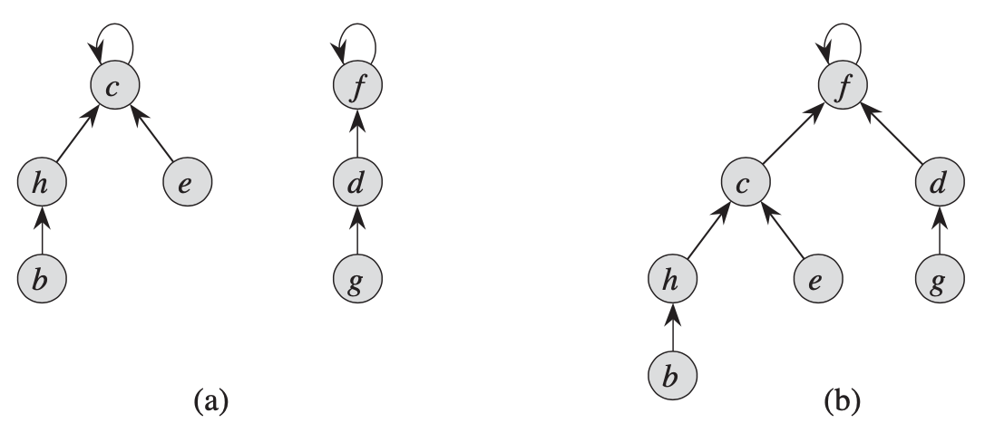
Disjoint-set Forests
Make-Set(x) creates a tree with one node.
Find-Set(x) follows parent pointers from x up to the root.
Union(x, y) causes the root of one tree to point to the root of the other.
A example of Union(e, g)

Slide 13
Union by Ranks
Make the root of the tree with fewer nodes point to the root of the tree with more nodes.
Rather than maintaining an exact count associated with each node, we will maintain an upper bound to the exact count, called the rank: it will be an upper bound on the height of the node
In a Union, the root with the smaller rank will be made to point at the root with the larger rank.

Slide 14
Path Compression
During a FIND() operation, compress the path along the chain of nodes so that, at the end, all the nodes in the chain point to the root.
Path Compression does not change any ranks.

Slide 15
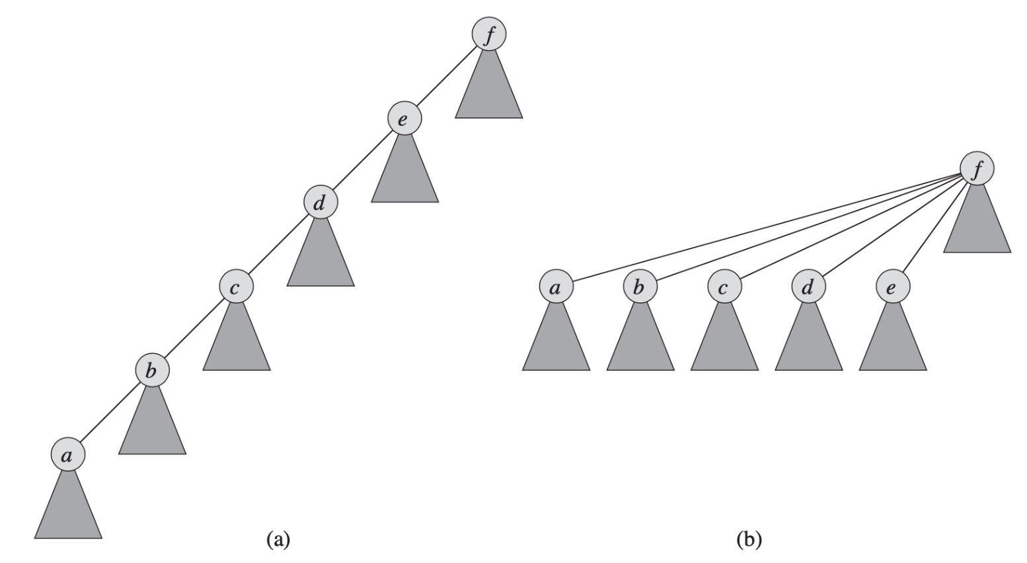
Path Compression
During FIND-SET operations: make each node on the find path point directly to the root.
Path compression does not change any ranks.

Slide 16
Pseudo-codes
MAKE-SET(x)
1 x.p = x
2 x.rank = 0
UNION(x, y)
1 LINK(FIND-SET(x), FIND-SET(y))
LINK(x, y)
1 if x.rank > y.rank
2 y.p = x
3 else x.p = y
4 if x.rank == y.rank
5 y.rank = y.rank + 1
FIND-SET(x)
1 if x ≠ x.p
2 x.p = FIND-SET(x.p)
3 return x.p

Slide 17



Analysis of Union by Rank & Path Compression
We define the “inverse” of the function A_{k}(n) for any integer n ≥ 0, by , which is the lowest level k for which A_{k}(1) is at least n. We can see:
We will show that a sequence of m MAKE-SET, FIND and UNION operations, of which n are MAKE-SER, will have a cost .
$$α\left(n\right)=min⁡\{k:A_{k}(1)≥n\}$$
$$α\left(n\right)=\left\{\begin{matrix}\begin{matrix}0 \\ \begin{matrix}1 \\ \begin{matrix}2 \\ \begin{matrix}3 \\ 4\end{matrix}\end{matrix}\end{matrix}\end{matrix} & \begin{matrix}\text{f}\text{or} 0≤n≤2 \\ \begin{matrix}\text{f}\text{or} n=3 \\ \begin{matrix}\text{f}\text{or} 4≤n≤7 \\ \begin{matrix}\text{f}\text{or} 8≤n≤2047 \\ \text{f}\text{or} 2048≤n≤A_{4}(1)\end{matrix}\end{matrix}\end{matrix}\end{matrix}\end{matrix}\right.$$
$$O(mα(n))$$

Slide 18

Theorem 21.13
A sequence of m Make-Set, Union and Find-Set operations, n of which are Make-Set operations, can be performed on a disjoint-set forest with union by rank and path compression in worst case time
Note: nearly linear, but not quite. Couldn’t get much closer though…
Question: could this lead to faster sorting algorithms? Why or why not?
$$O(mα(n))$$

